Slide 1
Image Registration: A Review
Xenios Papademetris
Department of Diagnostic Radiology
Yale School of Medicine

Slide 2
It’s all Greek to me!
Since people often ask ….
A Greek ‘X’ is pronounced as ‘KS’. It is in technical terms a double consonant.
Hence “Xenios” is pronounced “Ksenios”

Slide 3
Preliminary Note
I have made an effort to give a high-level view of image registration. There is not a single equation in the talk.
While all of the results shown in this talk are generated using our own methods, the emphasis is on the concepts rather than the specific methods.

Slide 4
Crude Definition
Image Registration is the process of estimating an optimal transformation between two images.
Sometimes also known as “Spatial Normalization” (SPM)

Slide 5
Applications of Image Registration
fMRI Specific
  Motion Correction
  Correcting for Geometric Distortion in EPI
  Alignment of images obtained at different times or with different imaging parameters
  Formation of Composite Functional Maps
Other Applications
  Mapping of PET/SPECT to MR Images
  Atlas-based segmentation/brain stripping
  And many many many more!

Slide 6
Talk Outline
Components of the Image Registration Process
Examples and Applications
Ongoing research work

Slide 7
Components of the Image Registration Process
Reference and Target datasets.
Transformation model
Similarity Criterion
Optimization Method

Slide 8
Reference and Target datasets.
Raw intensities often smoothed and re-sampled
Curves and Surfaces
Landmarks
Feature Images (e.g. edge images)
Combinations of the above

Slide 9
Transformation Model
Rigid
Affine
Piecewise Affine
Non-Rigid or Elastic

Slide 10
Rigid Transformation Model
Used for within-subject registration when there is no distortion
  e.g. MR to SPECT/PET Registration
Composed of 3 rotations and 3 translations
Linear – can be represented as a 4x4 matrix

Slide 11
Affine Transformation Model
Used for within-subject registration when there is global gross-overall distortion
  e.g. MR to CT Registration
More typically used as a crude approximation to fully non-rigid transformation.
Composed of 3 rotation, 3 translations, 3 stretches and 3 shears.
Also a linear transformation – can be represented as a 4x4 matrix

Slide 12
Piecewise Affine Transformation Model
First simple extension to fully non-rigid transformation
  Typically use different affine transformation for different parts of the image
Strictly speaking non-linear
The Talairach normalization approach falls in this category as it uses a different matrix transformation for each of the 12 pieces of the Talairach Grid
Next 4 slides courtesy of Larry Staib

Slide 13
Talairach Definition
Interhemispheric plane (3+ landmarks) ⇒ 2 rotations and 1 translation
Anterior and posterior commissure (AC, PC) ⇒ 3rd rotation, 2 translations
Scale to anterior, posterior, left, right, inferior, superior landmarks (7 parameters)
Each cerebral hemispheres divided into six associated blocks (interhemispheric plane, AC-PC axial plane, 2 coronal planes through AC and PC.

Slide 14
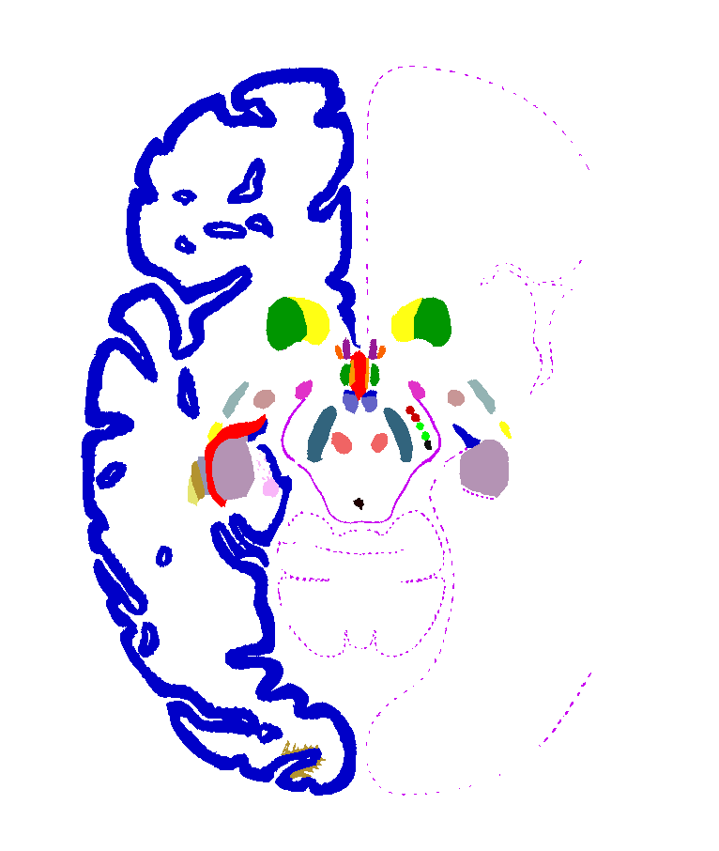
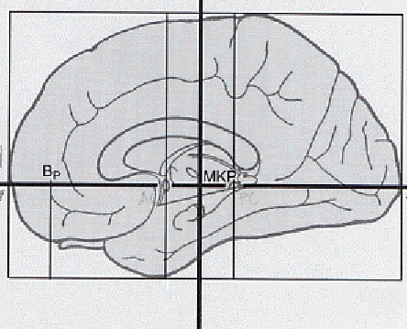
An Aside: Talairach Registration

Slide 15
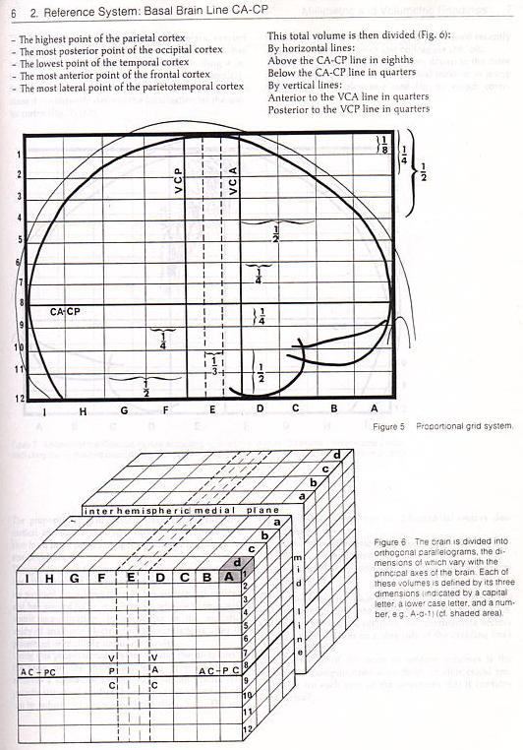

Slide 16
Problems
Developed for stereotaxic surgery of deep structures - not for cortex
Based on post mortem sections of 60-year-old female’s brain - not necessarily representative
Spatial normalization based on AC-PC does not accommodate most variable brain structures. Variability increases with distance from AC-PC
Only linear transformations (R,T,S).

Slide 17
Non-Rigid Transformation Model
Needed for inter-subject registration and distortion correction
Non-linear i.e. no matrix representation
Many Different Parameterizations e.g.
  General diffeomorphisms (e.g. fluid models)
  Spline parameterizations (b-splines, thin-plate splines)
  Fourier parameterizations (e.g. SPM)

Slide 18
Non-Rigid Transformation Model II
Often we need to explicitly control the degree of non-rigidity
  Use of smoothness constraints (e.g. bending energy or strain energy)
  Limited number of parameters (e.g. tensor splines)
Too much flexibility in the transformation can lead to undesirable results
  e.g. creating structures out of almost nothing

Slide 19
Similarity Metric
Intensity-based Methods
  Sum of Squared Differences
    Only valid for same modality with properly normalized intensities in the case of MR.
  Normalized Cross-Correlation
    Allows for linear relationship between the intensities of the two images
  Mutual Information
    More general metric which maximizes the clustering of the joint histogram.

Slide 20
The Joint Histogram
NCC Optimum
Y=ax+b
SSD Optimum
Y=x
Intensity of
Transformed
Target y
Intensity of Reference x

Slide 21
The Joint Histogram II
Mutual Information optimum --
Tightly clustered histogram
Intensity of
Transformed
Target y
Intensity of Reference x

Slide 22
Similarity Metric II
Feature-based Methods
  Distance between corresponding points
  Similarity metric between feature values
    e.g. curvature-based registration

Slide 23
Optimization Methods
Gradient Descent
Conjugate Gradient Descent
Multi-resolution search
Deterministic Annealing

Slide 24
Multiresolution
Most of the optimization methods are applied in a multi-resolution scheme. The following is typical:
  The registration is first run at a crude resolution e.g. the images are first resampled to 6x6x6 mm
  The results are used to initialize a second stage where the images are resampled at 3x3x3 mm
  The process is repeated once more with the images resampled to 1.5x1.5x1.5 mm

Slide 25
Talk Outline
Components of the Image Registration Process
Examples and Applications
Ongoing research work

Slide 26
Registration for fMRI Analysis
Motion Correction
Correcting for Geometric Distortion in EPI
Alignment of images obtained at different times or with different imaging parameters
Formation of Composite Functional Maps

Slide 27
Creating Composite Activation Maps
Reference 3D Image
Each Subject
Non-Rigid Registration
(Difficult)
3D Image
Rigid Registration
(Easy)
Conventional
Distortion Correction
(Moderately Difficult)
EPI Reference
Motion Correction
(Difficult)
T2* Image Series

Slide 28
Motion Correction
Current Common Practice
  e.g. SPM99
    Transformation model : rigid (3 translations, 3 rotations)
    Reference Image – a single T2* image
    Similarity Metric: Sum of Squared Differences (*)
State of the Art
  Integrated motion and distortion correction (recently in SPM02 -- not tested)
    Transformation model : fully non-rigid
    Reference Image – a single T2* image
    Similarity Metric: Sum of Squared Differences (*)
  Current work in progress here (see next slide)

Slide 29
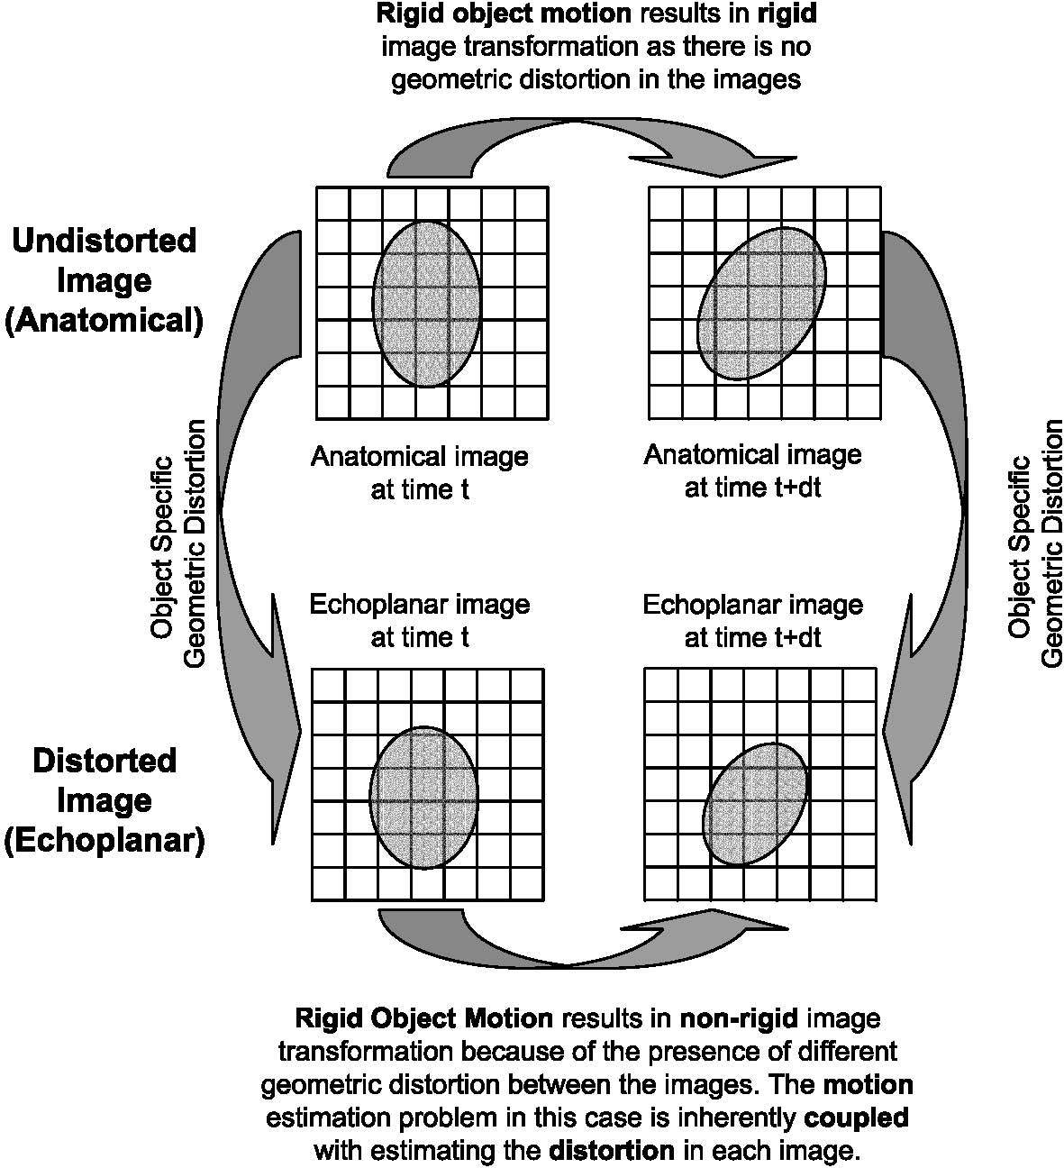

Slide 30
Geometric Distortion Correction in EPI
Current Common Practice
  Simple Translation (e.g. Pawel’s package)
  Simple Translation + Global Scale (Todd)
  Perhaps Rigid registration to account for global head motion
State of the Art
  Field Map based distortion correction
  Non-rigid distortion correction guided by acquisition models
  Integrated form of the above two (in-progress)

Slide 31
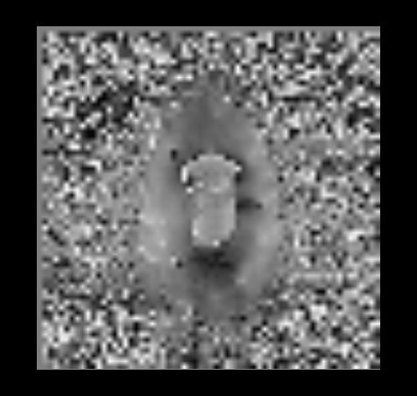
Field Map Measurements of Distortion
Can measure distortion directly using field mapping (distortion is a function of the magnetic field inhomogeneity). While not perfect it can give a good initial distortion correction.

Slide 32
Image Registration Based Distortion Correction
Similarity Metric:
  Jacobian Weighted Mutual Information to account for intensity modulation by the distortion
Transformation Model
  Fully non-linear tensor-spline grid with non-rigid displacement restricted into the phase-encode direction (where distortion is present)
Original work by Studholme, Constable and Duncan (1999,2000)

Slide 33
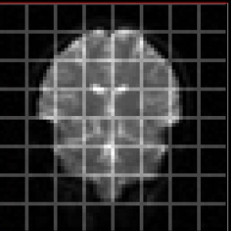
Tensor Spline Grid Transformation Model
Control Point
Spacing (flexibility of
Transformation)
Control
Point
The transformation is specified by the displacements of the control points. The
displacement at any given point (x,y,z) is given by interpolating the displacements
of the control points using a tensor B-spline grid. For EPI distortion correction the control points are restricted to move only in the phase-encode direction (vertical.)

Slide 34
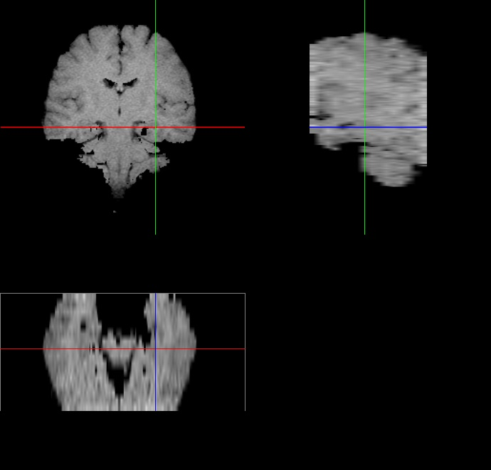
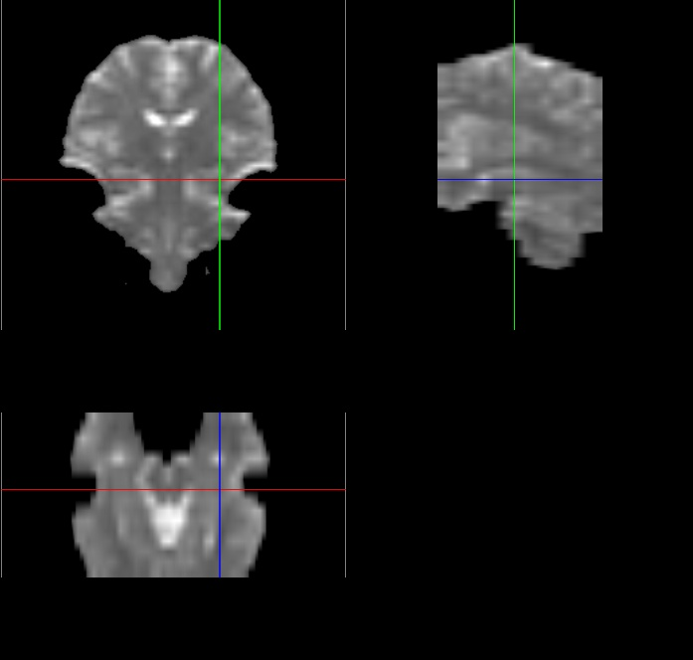
Example of Application -- Before

Slide 35
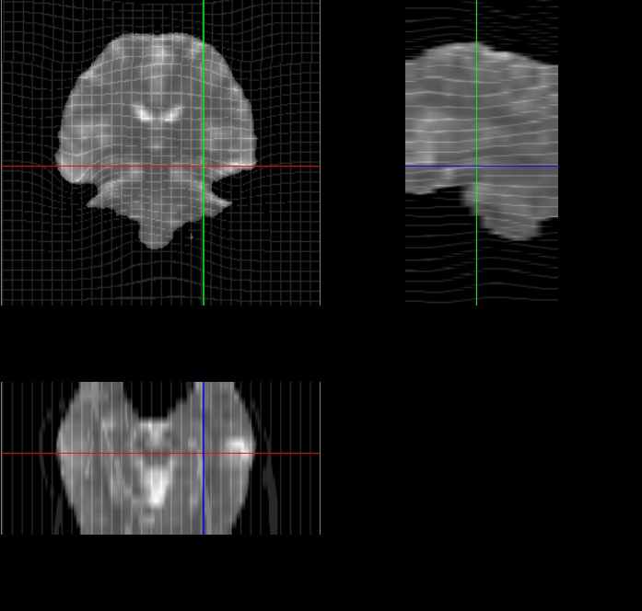
Example of Application -- After

Slide 36
Within-subject rigid registration
This is probably the only truly “solved” problem in medical image analysis
Transformation Model
  Rigid Registration
Similarity Metric
  Normalized Mutual Information (NMI)
    NMI differs from standard MI in that it accounts for the degree of overlay between the two images and hence can be used to align part of the brain to whole brain images.
Optimization Method
  Multi-resolution Hill Climbing

Slide 37
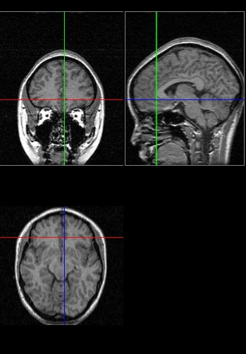
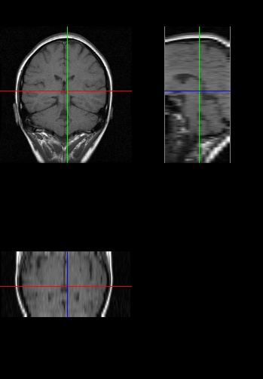
Within-subject rigid registration -- Example
Full 3D Anatomical Image
Conventional Anatomical Image

Slide 38
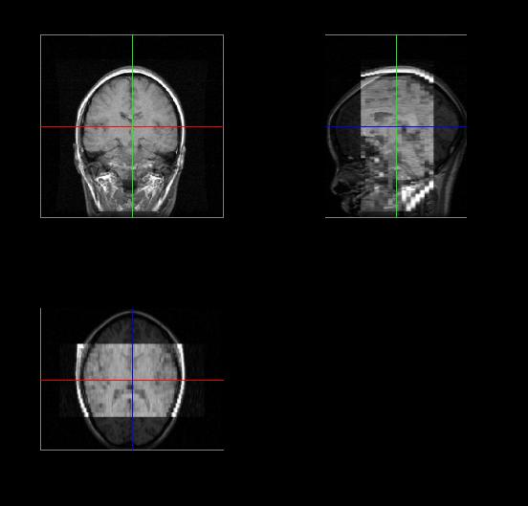
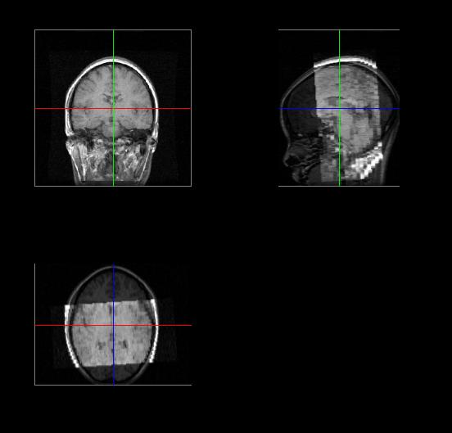
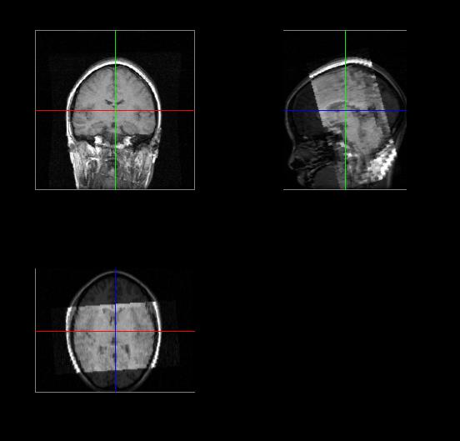
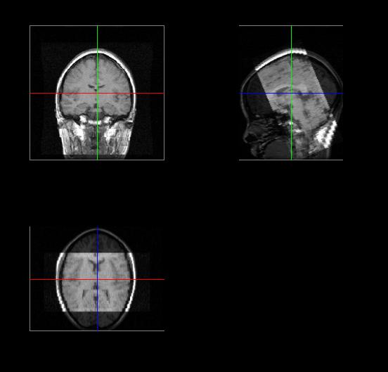
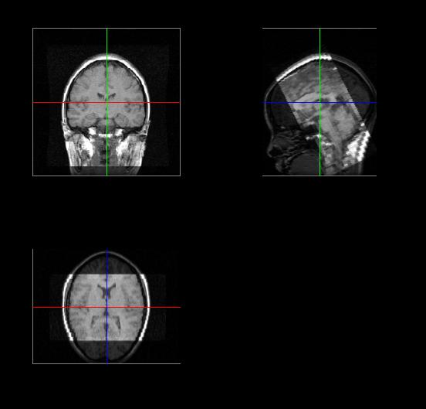

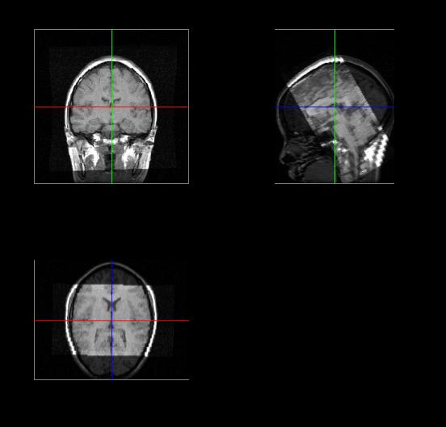
Within-subject rigid registration – Example II

Slide 39
Registration for Multisubject fMRI Analysis
This is an “unsolved problem”
Transformation Model
  Generally Non-linear but many different choices
Similarity Metric
  Lots and lots of choices
    Sum of Squared Differences
    Normalized Cross Correlation
    Normalized Mutual Information (NMI)
Optimization Method
    Some form of multiresolution gradient descent

Slide 40
Example of Non-Rigid Registration
Generalization of Approach for distortion correction.
First an affine transformation is used for initialization.
Transformation Model
    Tensor-spline grid with control points free to move in all directions
Similarity Metric
    Normalized Mutual Information (NMI).
Optimization Method
    Multiresolution conjugate gradient descent

Slide 41
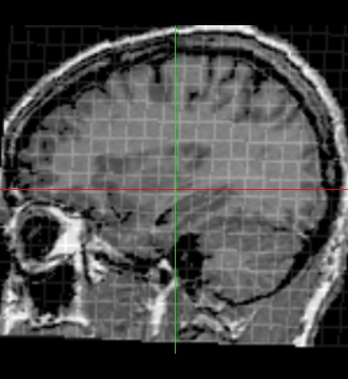
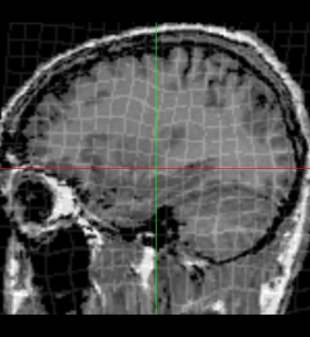
Affine vs Non-Rigid – A Look at the transformation
Affine – 12 parameters
Non-Rigid ~ 2000 parameters

Slide 42
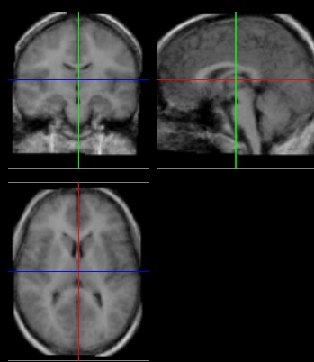
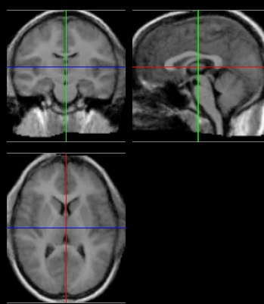
Affine vs Non-Rigid
Affine
Non-Rigid
Average Anatomical Images from 10 Subjects displayed at 1.5x1.5x1.5 mm

Slide 43
Registration for Multisubject fMRI Analysis
Non-rigid registrations is the key limiting step towards improved composite functional map resolution.
Currently all T2* images are often smoothed with an 8mm FWHM filter as a standard pre-processing step.

Slide 44
Rationale for the Smoothing (Friston et al)
Expected (??) response size about 2mm
Limitations imposed by Central Limit Theorem (2-5 mm)
Critically inter-subject registration (8mm)
  Inability to register cortical anatomical landmarks accurately
  Variability in the location of functional foci in the individual anatomy.

Slide 45
Effect of Registration Inaccuracy
Best resolution of functional maps for multi-subject registration is 8mm
Should be acquiring 8x8x8 mm resolution fMRI to maximize signal-to-noise ratio
OR
Improve the Registration procedures.

Slide 46
Point-based Non-rigid Registration
Intensity-based methods work well in the sub-cortex
Geometrical complexity of the Cortex makes intensity-based registration error—prone in that region
  Different numbers of sulci in different subjects
  Sulcal branching and breaking
Attempted solution – point based registration with explicit sulcal definitions

Slide 47
Talk Outline
Components of the Image Registration Process
Examples and Applications
Ongoing research work

Slide 48
Computing 3D Non-rigid Brain Registration Using Extended Robust Point Matching for Composite Multisubject fMRI Analysis
Xenophon Papademetris³, Andrea P. Jackowski³,
Robert T. Schultz³, Lawrence H. Staib¹² and James S. Duncan¹²
¹ Departments of Electrical Engineering, ² Diagnostic Radiology,
and ³ Yale Child Study Center,
Yale University New Haven, CT 06520-8042
(To appear in MICCAI 2003)

Slide 49
Point-based Non-rigid Registration II
Method only as good as the work one is willing to put in extracting features
  e.g. sulcal tracing
Regional focus unlike intensity based methods. Accurate in regions where features have been pre-extracted, less accurate elsewhere.
Often useful when there is a specific area of great interest e.g. the fusiform gyrus.

Slide 50
Point-based Non-rigid Registration III
Method extends the robust point matching framework of Chui and Ragaranjan.
Can handle outliers in both the reference and the template
  This allows the method to handle missing structures e.g. different numbers of sulci.

Slide 51
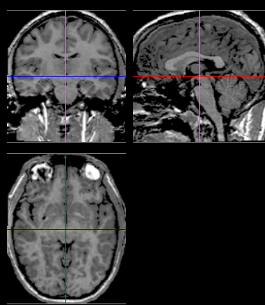
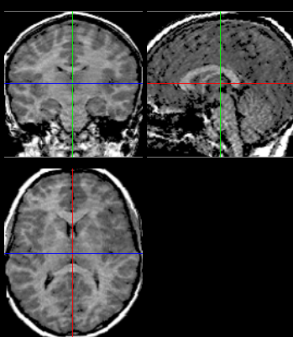
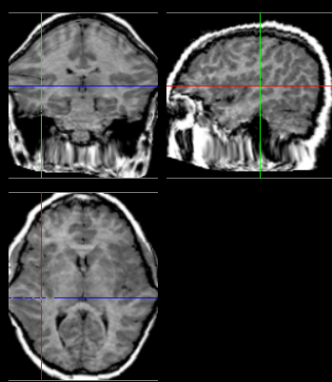
Robustness Example
Intensity Based Method
(a)
(b)
(c)

Slide 52
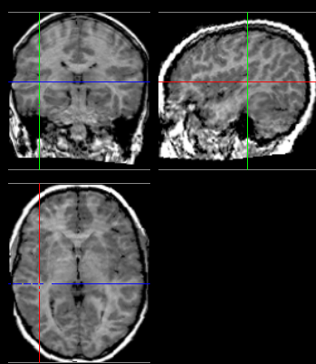
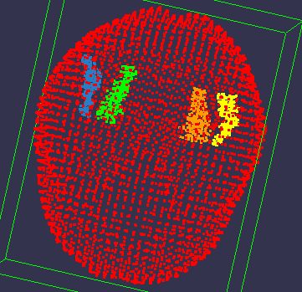
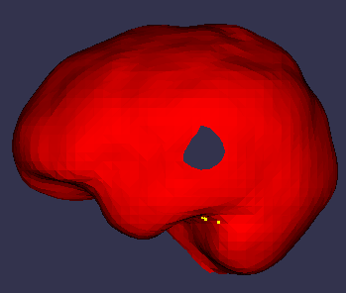
Robustness Example
Point-Based Method
(b)

Slide 53
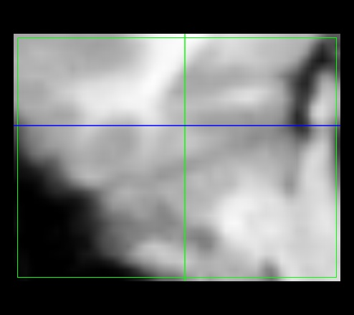
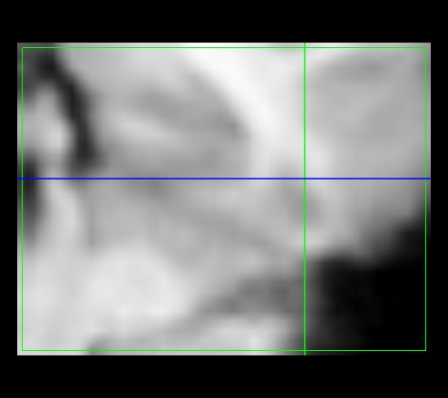
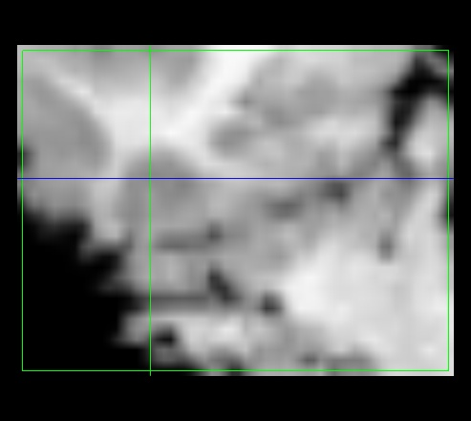
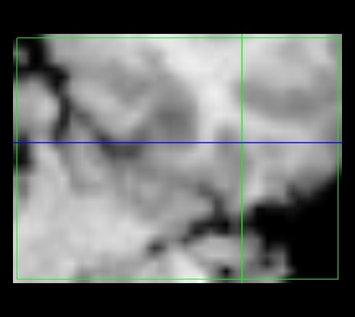
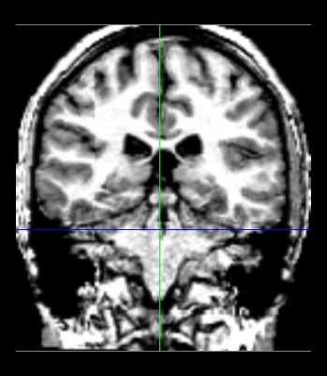
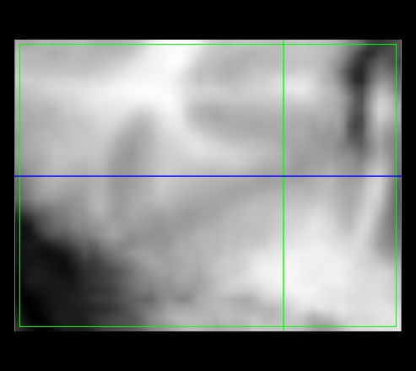
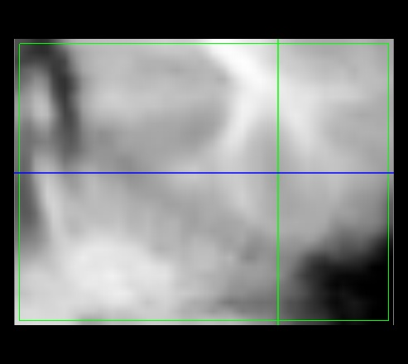
Anatomical Composites in the region of the fusiform gyrus
Intensity Based Registration
Original Anatomical Reference
Point Based Registration

Slide 54
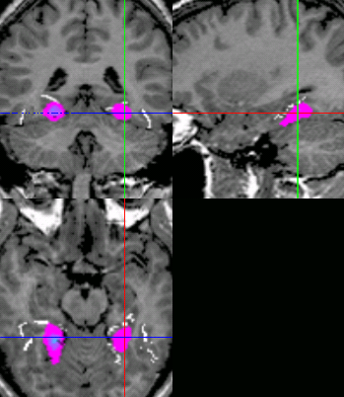
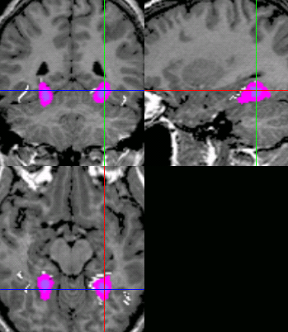
Composite Functional Maps I
R
L
R
L
Composite
using
intensity-
based
registration
Composite
using
point-
based
registration

Slide 55
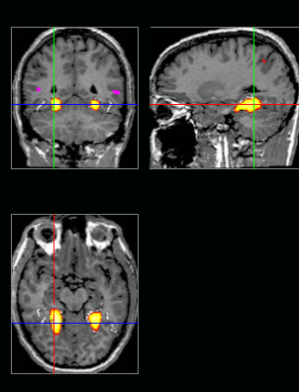
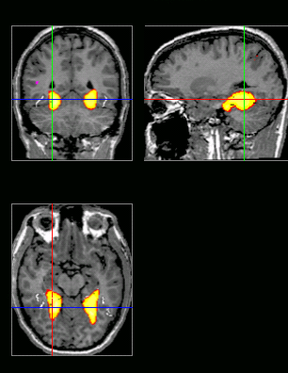
Composite Functional Maps II
Composite
using
intensity-
based
registration
Composite
using
point-
based
registration

Slide 56
Conclusions
Image Registration is ubiquitous in fMRI analysis especially in the case of multisubject studies.
This is still very much an area of active research although some turn-key solutions are around.

Slide 57
Suggestions
When planning for a multisubject fMRI study
  Please acquire a complete 3D anatomical image for each subject – it makes life much easier.
  Think in terms of acquiring a field map as well (this should become part of the standard protocol)

